Slide 1

Investigate Business Hotel using Data Visualization
Created by:
Muhammad Cikal Merdeka
Email : mcikalmerdeka@gmail.com
LinkedIn : linkedin.com/in/mcikalmerdeka
Github : github.com/mcikalmerdeka
Dedicated entry-level data scientist with analytical and experimental background of Physics. My graduation 2023, a pivotal year marked by significant advancements in artificial intelligence with the introduction of GPT-4 and other generative AI models, has fueled my curiosity and excitement to delve into the field of data. I have comprehensive grasp of data science methodology from business understanding to modelling process with proficiency in Python, SQL, Tableau, Power BI, Looker Studio and other tools related to data analytics workflow from several coursework and bootcamps.

Slide 2
Monthly Hotel Booking Analysis Based on Hotel Type
In the hotel business, customer behavior analysis is crucial as it is closely related to the number of bookings made, which directly impacts the company's revenue. Therefore, analyzing customer behavior when booking hotels is essential. For example, we can identify which types of hotels are most preferred by customers and correlate them with the seasonal conditions when the hotels are booked. At this stage, we will seek a comparison of the number of hotel bookings each month based on the hotel type.
The steps involved are as follows:
Creating an aggregate table showing the comparison of hotel bookings each month based on the hotel type.
Normalize the data due to inconsistencies in data availability.
Creating plots that illustrate the fluctuations in the increase or decrease of hotel bookings each month based on the hotel type.
Writing interpretations of the results from the plots in the previous step.

Slide 3
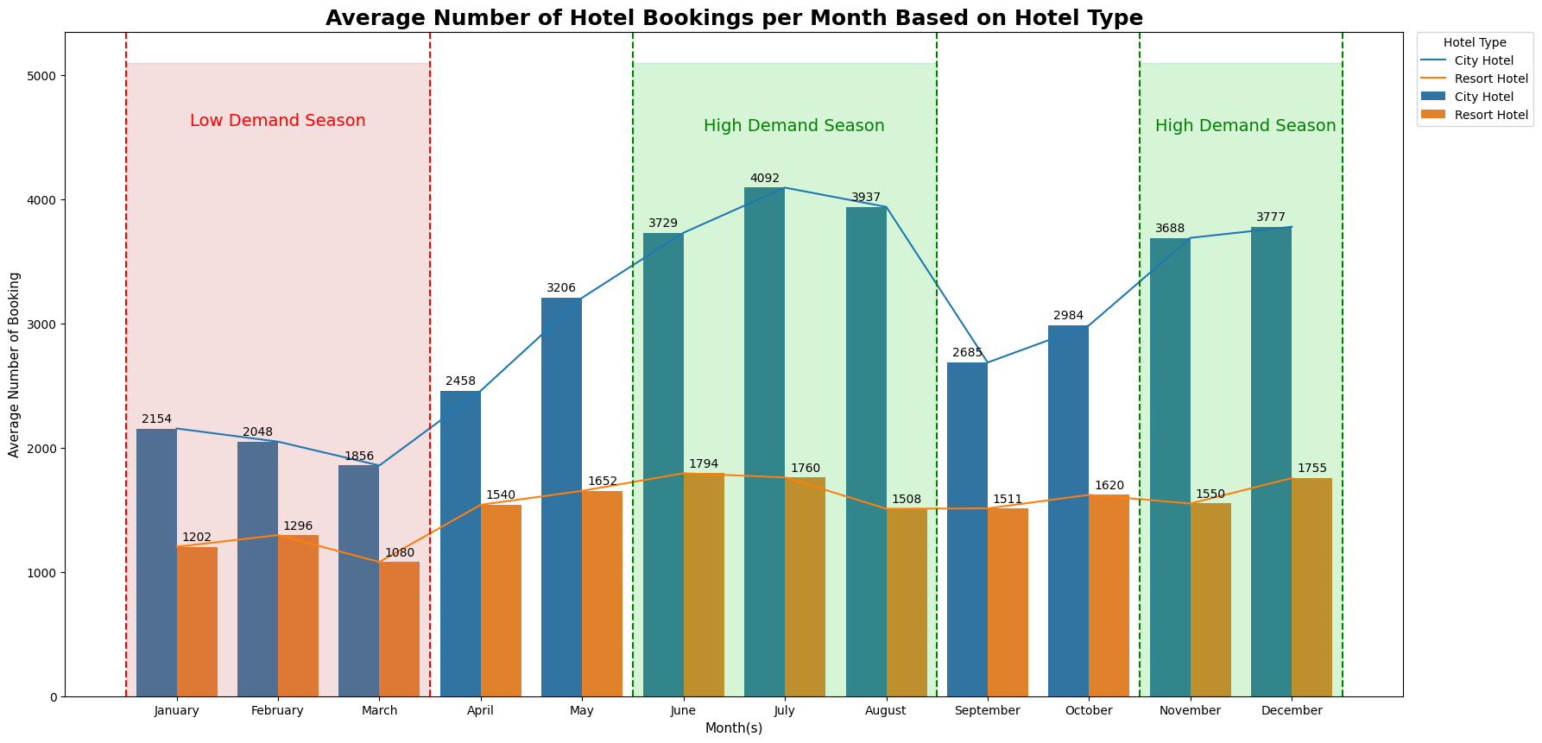
Monthly Hotel Booking Analysis Based on Hotel Type
Data Visualization :

Slide 4
Monthly Hotel Booking Analysis Based on Hotel Type
Data Interpretation and Business Recommendation :
Both types of hotels experience similar trends of increase and decrease, with a more significant increase in City Hotels, which overall have a higher number of bookings compared to resort hotels in Indonesia.
It can be seen that the peak increase in hotel bookings occurs around June-August and November-December, which may be due to the fasting month holidays in 2017-2018 (according to data collection) and end-of-semester/year holidays for the entire Indonesian population. To address this increase, hotels can implement several strategies including:
Plan targeted marketing campaigns leading up to these peak periods. Highlight offers and packages suitable for families during school breaks and special deals for those observing Ramadan.
Create tailored packages that cater to different segments of customers, such as families, couples, and solo travelers. Offer special discounts or perks for longer stays during peak periods.
Anticipate higher demand during peak seasons and ensure adequate staffing levels to maintain high-quality service. Consider offering additional amenities or services to enhance the guest experience.
Encourage early bookings by offering discounts or exclusive deals for customers who book their stays well in advance. This can help in managing demand and securing reservations ahead of time.

Slide 5
Monthly Hotel Booking Analysis Based on Hotel Type
Data Interpretation and Business Recommendation :
The decrease in hotel bookings occurs in the early months of the year, January-March, and also in September-October, with a noticeable decrease in City Hotels. This may be related to the resumption of activities for students and workers. The main actions that can be taken by hotel businesses during this period include:
Develop enticing weekend getaway packages to attract local residents looking for short escapes during these slower periods. Offer special rates, complimentary meals, or leisure activities to entice weekend travelers.
Forge partnerships with local businesses and corporations to secure corporate bookings during off-peak periods. Offer discounted rates or corporate loyalty programs to incentivize companies to choose hotel for their accommodation needs.

